Slide 1
Zomato Restaurant Sql Project

Slide 2
Objective
The "Zomato Restaurant Data Analysis" project aims to uncover valuable insights from the extensive dataset. By leveraging SQL, this project focuses on analyzing various aspects of restaurant data, including distribution, popularity, pricing, and customer preferences. The ultimate goal is to derive actionable insights that can benefit restaurant owners, customers, and industry analysts.

Slide 3
Tables
Restaurant ( table1)
RestaurantId
RestaurantName Has_table_booking Has_online_delivery Switch_to_order_menu
Is_deliver_now Average_cost_for_two Rating Votes Price_range
Restaurant_address (table2)
RestaurantId
Country
CountryCode
City
Locality
LocalityVarbose
Address
Cuisines
Currency
Notes:
In both table RestaurantId is common in Table1 RestaurantId is primary key and in second Table2 RestaurantId is foreign key.

Slide 4
Tools And Technique
Tools
SQL: Primary tool for querying and analyzing the dataset.
RDBMS: A relational database management system such as MySQL to store and manage the Zomato dataset.
Technique
Data Cleaning: Ensuring the dataset is free from inconsistencies and missing values.
Descriptive Analysis: Using SQL queries to summarize the main characteristics of the dataset.
Exploratory Data Analysis (EDA): Diving deeper into the data to find patterns, trends, and relationships.
Aggregations and Grouping: Applying SQL functions to aggregate data for summarization and insights.
Join Operations: Combining data from different tables to enrich the analysis.
.

Slide 5
Methodology
Data Import and Setup:
Import the Zomato dataset into an RDBMS.
Create two tables: one for restaurant details and the other for restaurant location.
Data Cleaning:
Inspect the dataset for missing or inconsistent values.
Perform necessary data cleaning operations to ensure data quality.
Data Exploration:
Perform basic queries to understand the distribution of restaurants across cities and countries.
Analyze the various cuisine types available and their prevalence.
Descriptive Analysis:
Calculate average ratings and cost for two across different cities and cuisines.
Identify the number of restaurants offering online delivery or table booking.
Advanced Analysis:
Use JOIN operations to combine data from different tables for enriched insights.
Apply aggregation and grouping to find the most popular cuisines and the cities with the highest-rated restaurants.

Slide 6
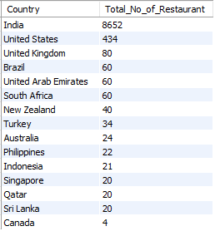
List the total number of restaurants in each country
SELECT
Country, COUNT(*) AS Total_No_of_Restaurant
FROM
restaurant_addresss
GROUP BY Country
ORDER BY Total_No_of_Restaurant DESC;

Slide 7
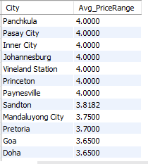
Find the average price range of restaurants in each city
SELECT
City, AVG(Price_range) AS Avg_PriceRange
FROM
restaurant_addresss
JOIN
restaurant ON restaurant_addresss.RestaurantId = restaurant.RestaurantId
GROUP BY City
ORDER BY Avg_PriceRange DESC;

Slide 8
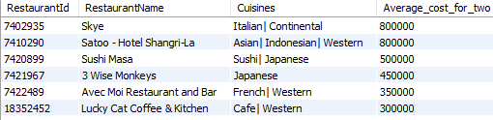
Get the names of all restaurants along with their cuisines and average cost for two, ordered by cost in descending order.
SELECT
restaurant.RestaurantId,
RestaurantName,
Cuisines,
Average_cost_for_two
FROM
restaurant
JOIN
restaurant_addresss ON restaurant.RestaurantId = restaurant_addresss.RestaurantId
ORDER BY Average_cost_for_two DESC;

Slide 9

Count the number of restaurants that have online delivery available in each country
SELECT
Country,
COUNT(*) AS Total_no_of_Restaurant_has_online_delivery
FROM
restaurant_addresss
JOIN
restaurant ON restaurant_addresss.RestaurantId = restaurant.RestaurantId
WHERE
Has_Online_delivery = 'Yes'
GROUP BY Country;

Slide 10
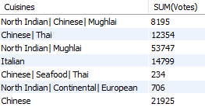
Calculate the total number of votes for each cuisine type across all cities
SELECT
Cuisines, SUM(Votes)
FROM
restaurant_addresss
JOIN
restaurant ON restaurant_addresss.RestaurantId = restaurant.RestaurantId
GROUP BY Cuisines;

Slide 11

Find the top 3 cities with the highest average rating for restaurants
SELECT
City, ROUND(AVG(Rating), 2) AS Avg_rating
FROM
restaurant_addresss
JOIN
restaurant ON restaurant_addresss.RestaurantId = restaurant.RestaurantId
GROUP BY City
ORDER BY Avg_rating DESC
LIMIT 3;

Slide 12
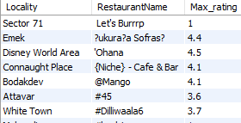
Determine the restaurant with the highest rating in each locality
SELECT
Locality, RestaurantName, MAX(Rating) AS Max_rating
FROM
restaurant_addresss
JOIN
restaurant ON restaurant_addresss.RestaurantId = restaurant.RestaurantId
GROUP BY Locality , RestaurantName
ORDER BY RestaurantName ASC , Max_rating DESC;

Slide 13
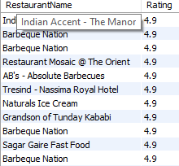
Identify the restaurants with ratings above the average rating of all restaurants
SELECT
RestaurantName, Rating
FROM
restaurant
WHERE
Rating > (SELECT
AVG(Rating)
FROM
restaurant)
ORDER BY Rating DESC;

Slide 14
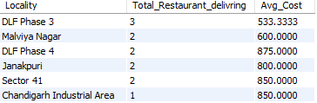
List the number of restaurants delivering now in each locality along with their average cost for two
SELECT
Locality,
COUNT(*) AS Total_Restaurant_delivring,
AVG(Average_cost_for_two) AS Avg_Cost
FROM
restaurant_addresss
JOIN
restaurant ON restaurant_addresss.RestaurantId = restaurant.RestaurantId
WHERE
Is_delivering_now = 'Yes'
GROUP BY Locality
ORDER BY Total_Restaurant_delivring DESC;

Slide 15
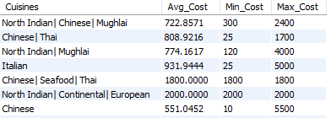
Calculate the average, minimum, and maximum cost for two for each cuisine type
SELECT
Cuisines,
AVG(Average_cost_for_two) AS Avg_Cost,
MIN(Average_cost_for_two) AS Min_Cost,
MAX(Average_cost_for_two) AS Max_Cost
FROM
restaurant_addresss
JOIN
restaurant ON restaurant_addresss.RestaurantId = restaurant.RestaurantId
GROUP BY Cuisines;

Slide 16
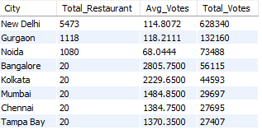
Get the total number of restaurants, and the average and total votes for restaurants in each city, ordered by total votes in descending order
SELECT
City,
COUNT(*) AS Total_Restaurant,
AVG(Votes) AS Avg_Votes,
SUM(Votes) AS Total_Votes
FROM
restaurant_addresss
JOIN
restaurant ON restaurant_addresss.RestaurantId = restaurant.RestaurantId
GROUP BY City
ORDER BY Total_Votes DESC;

Slide 17

Identify restaurants that have has Online Delivery and their average rating compared to those that haven't
SELECT
ROUND(AVG(Rating), 2) AS Avg_rating, Has_Online_delivery
FROM
restaurant
GROUP BY Has_Online_delivery;

Slide 18
Insights
Restaurant Distribution:
The dataset reveals a diverse distribution of restaurants across multiple cities and countries, with certain cities hosting a higher concentration of dining options.
Cuisine Popularity:
Certain cuisines, such as Italian, Chinese, and Indian, are more prevalent across the dataset, indicating popular food preferences among users.
Cost Analysis:
There is a noticeable variation in the average cost for two across different cities and cuisines. Metropolitan cities tend to have higher average costs compared to smaller towns.
Online Delivery and Table Booking:
A significant number of restaurants offer online delivery, reflecting the growing trend of food delivery services. However, fewer restaurants provide table booking services.
Top-Rated Restaurants:
The analysis identifies the highest-rated restaurants in various cities, helping users discover top dining options. Restaurants with higher ratings often correlate with a higher number of votes, indicating strong customer satisfaction.

Slide 19
Thankyou

